Slide 1



MEDIBOT: AUTOMATIZED MEDICAL CHATBOT

Slide 2

MEDIBOT: AUTOMATIZED MEDICAL CHATBOT
In the age of digital transformation, advancements in technology have revolutionized various sectors, including healthcare. One such innovation that has garnered attention is the development of Medibot, an automatized medical chatbot. Medibot represents a cutting-edge application of artificial intelligence (AI) in healthcare, aiming to enhance patient care, streamline medical processes, and provide accessible medical assistance round the clock.

Slide 3

01 Revolutionizing Healthcare
The age of digital transformation has led to revolutionary advancements in healthcare, with Medibot at the forefront of innovation.
02 AI Integration
INTRODUCTION
Medibot is a prime example of the seamless integration of AI in the healthcare sector, offering a glimpse into the future of medical assistance.
03 Enhanced Patient Care
Medibot's development signifies a pivotal shift in providing enhanced patient care through technological advancements.

Slide 4

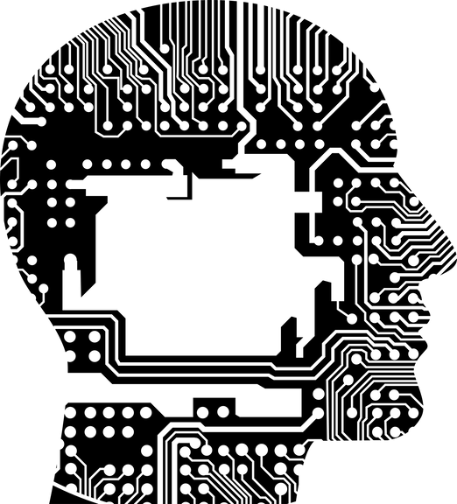
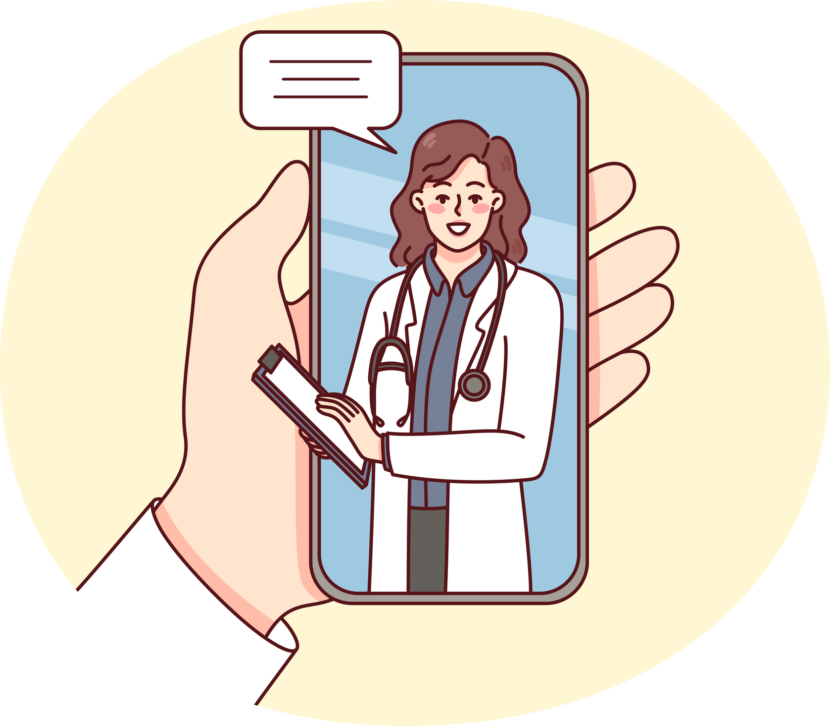
Virtual Assistant
Medibot operates as a virtual assistant, utilizing natural language processing and machine learning algorithms to engage in conversations with users.
AI Integration
It represents the seamless integration of AI and healthcare services, offering accessible medical assistance round the clock.
Understanding Medibot
Medical Advice
Medibot comprehends users' medical concerns and offers relevant medical advice and information, showcasing the potential of AI in healthcare.

Slide 5

Features and Functionality
01
02
03
Interactive Interface
Symptom Assessment
Medical Information Repository
Medibot features a user-friendly interface that allows patients to communicate their symptoms, medical history, and queries conveniently.
Through a series of structured questions, Medibot conducts a comprehensive assessment of symptoms reported by the user, aiding in preliminary diagnosis and suggesting appropriate actions.
Equipped with an extensive database comprising medical literature, treatment protocols, and health guidelines, Medibot provides reliable medical information to users.

Slide 6
Appointment Scheduling
Seamless Integration
Medibot integrates with hospital systems, facilitating the scheduling of appointments with healthcare professionals based on user preferences and availability.
Time Management
Efficiently manages user appointments, optimizing healthcare workflows and reducing waiting times.

Slide 7
Emergency Assistance
Swift Identification
Medibot swiftly identifies emergencies and guides users on immediate actions to be taken, including contacting emergency services or seeking urgent medical attention.
Urgent Guidance
Provides urgent guidance in critical situations, ensuring users receive timely and potentially life-saving assistance.

Slide 8

Benefits of Medibot
Accessibility
Medibot transcends geographical barriers and time constraints, providing instant medical assistance to users anytime, anywhere.
Efficiency
By automating routine medical tasks and inquiries, Medibot optimizes healthcare workflows, reduces waiting times, and enhances operational efficiency for healthcare providers.
Personalized Care
Through continuous learning and data analysis, Medibot tailors responses and recommendations according to individual user profiles and medical histories, ensuring personalized care and support.

Slide 9
Health Awareness
Informative Resource
Medibot serves as a valuable resource for health education and awareness, empowering users to make informed decisions regarding their well-being and preventive healthcare practices.
Empowering Users
Empowers users with the knowledge and information necessary to take charge of their health and well-being, promoting a proactive approach to healthcare.

Slide 10
Conclusion
Revolutionizing Patient Care
Medibot represents a paradigm shift in healthcare delivery, leveraging AI technologies to empower patients, streamline medical processes, and augment clinical decision-making.
Health Literacy
As the healthcare landscape evolves, Medibot stands poised to revolutionize patient care, foster health literacy, and create a more accessible and equitable healthcare ecosystem.

